Slide 1




Week-1 (Discussion)
30th July, 2024
Introduction to Machine Learning
Prof. Balaraman Ravindran
Professor and Head of the Department
Department of Data Science and Artificial Intelligence
IIT Madras
Ayan Paul
PMRF Research Scholar
IIT Kharagpur

Slide 2
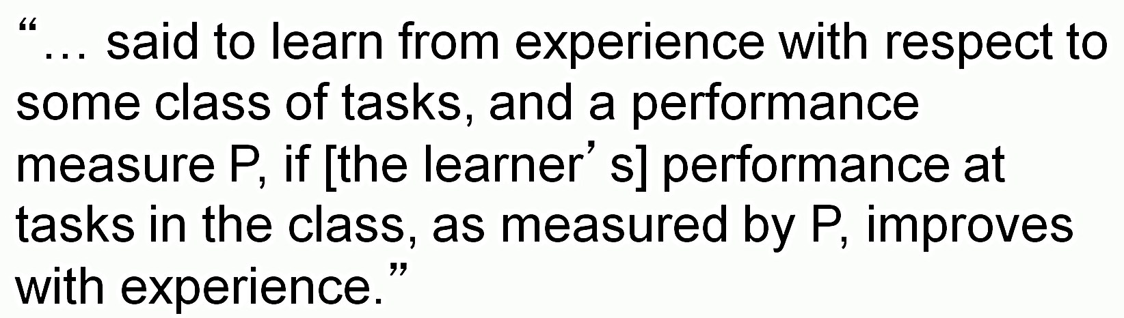
WHAT IS MACHINE LEARNING?
Tom Mitchell, 1997

Slide 3
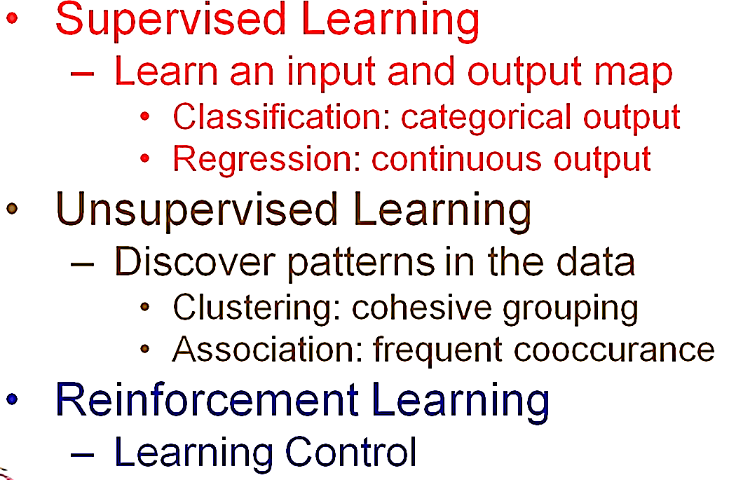
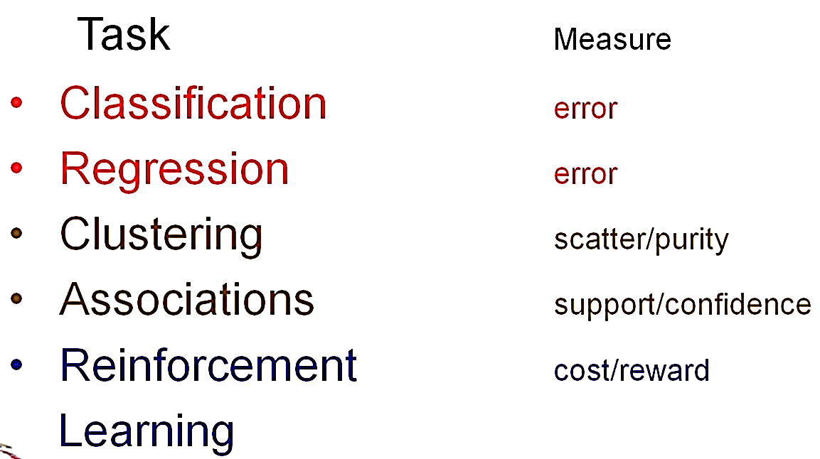
ML Paradigm
Performance Measure

Slide 4
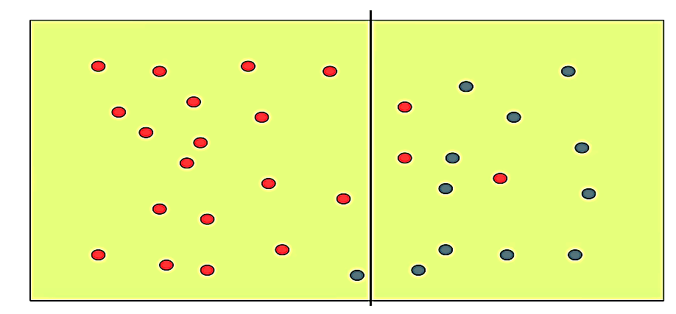
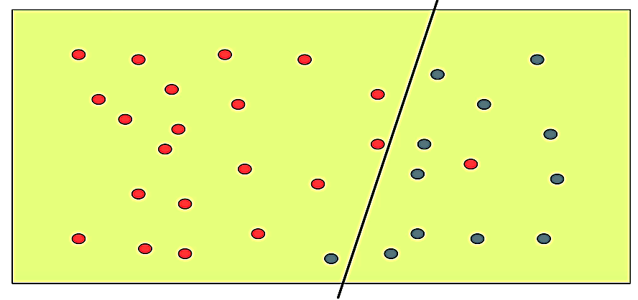
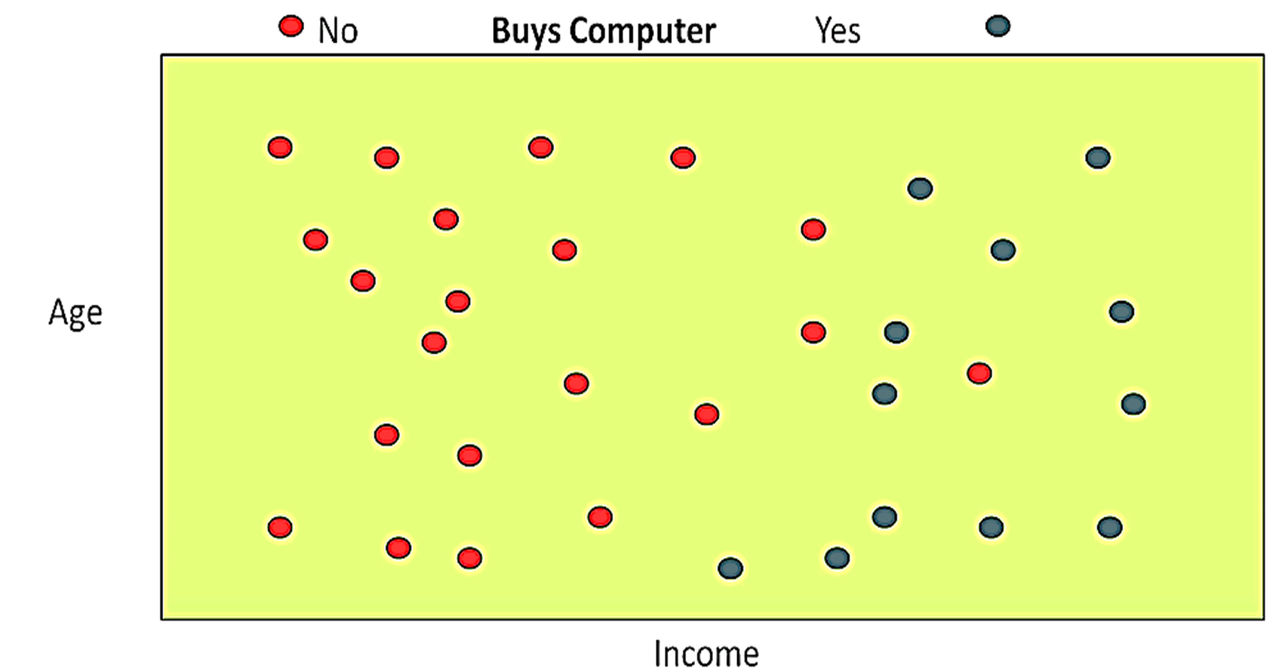
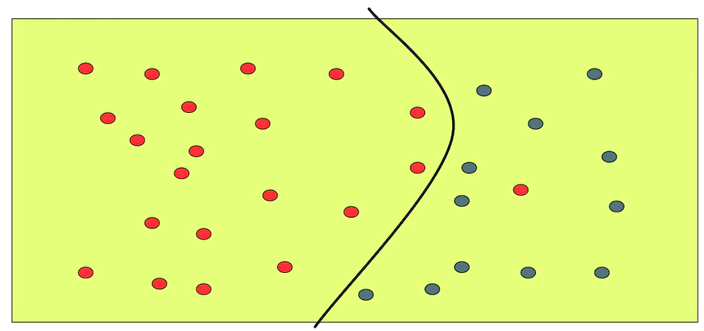
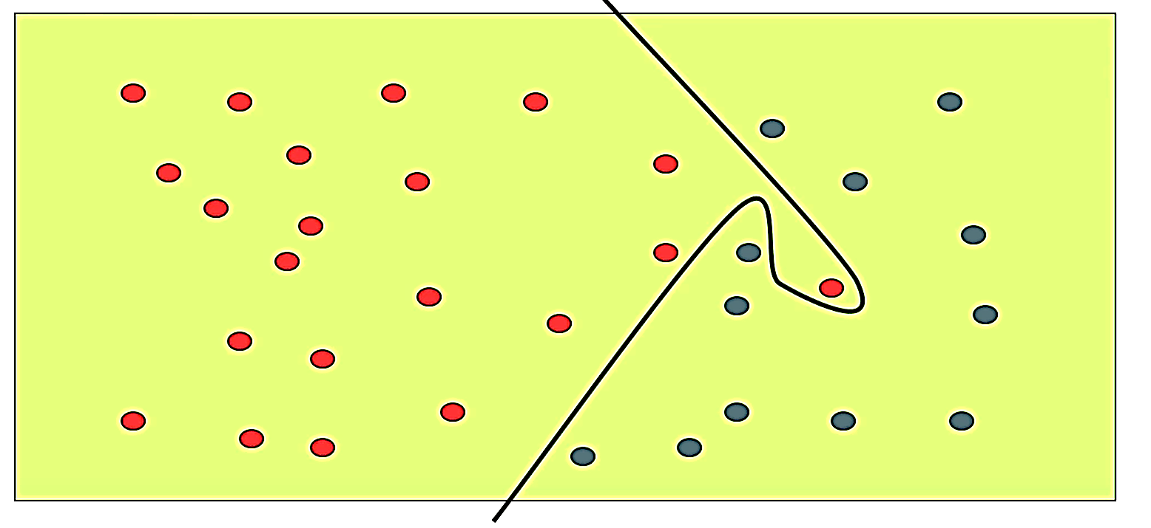
Supervised Learning
Classification
Classifiers
Labelled Training Data

Slide 5
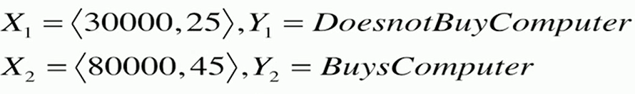
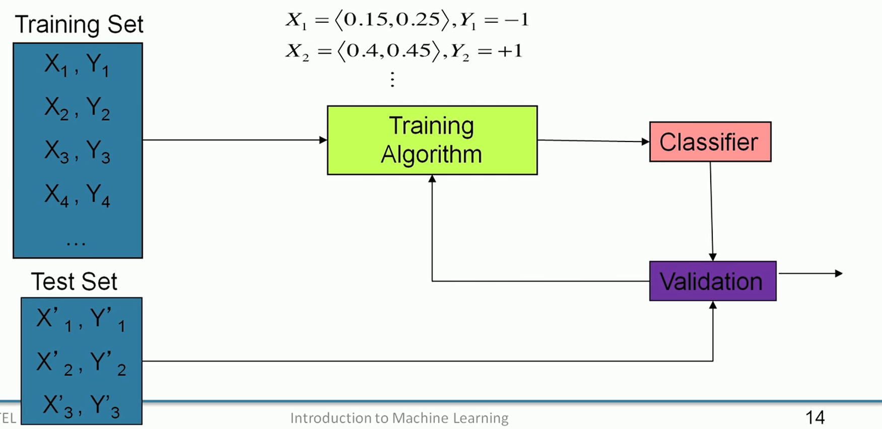
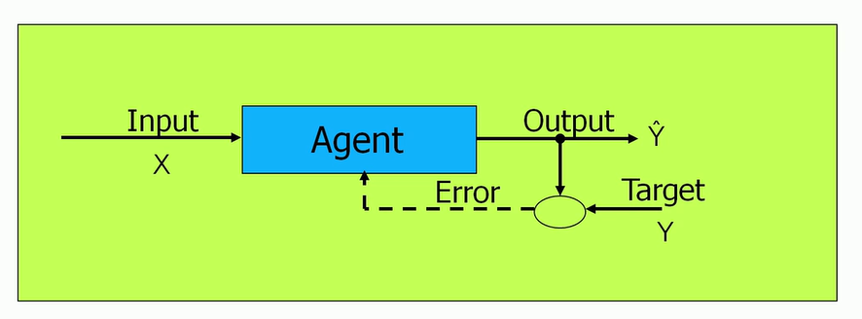
Process
Training

Slide 6
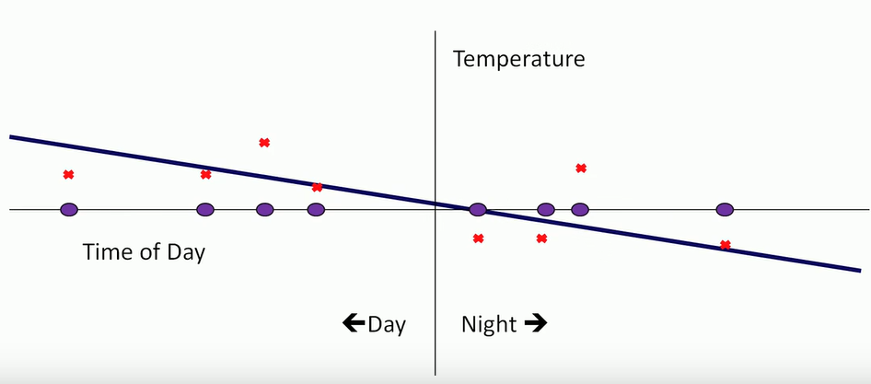
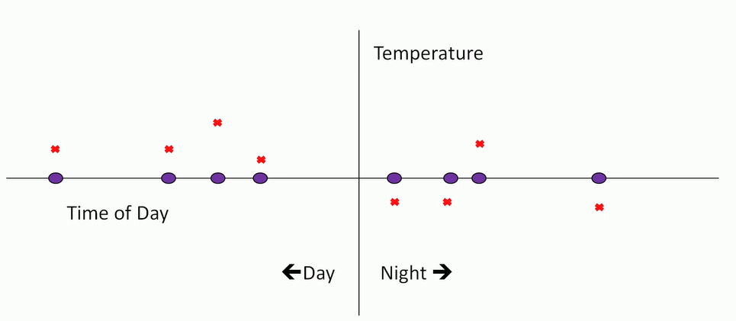
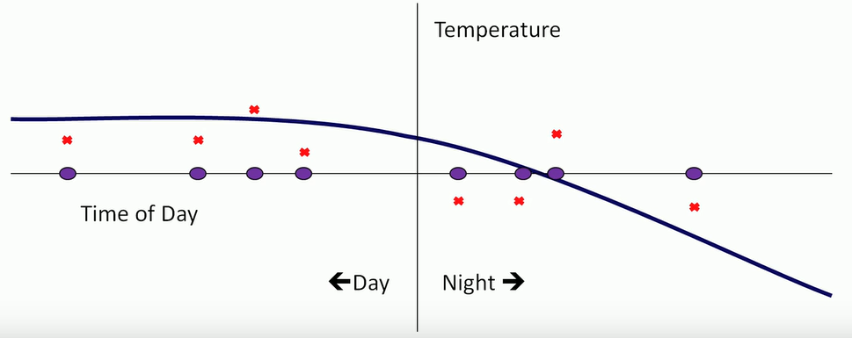
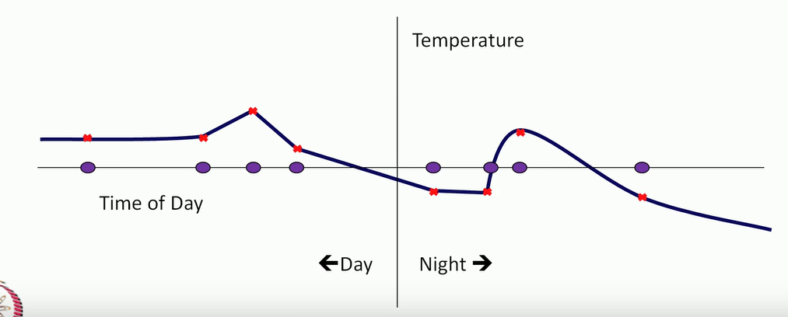
Regression Models
Regression
Training Data

Slide 7
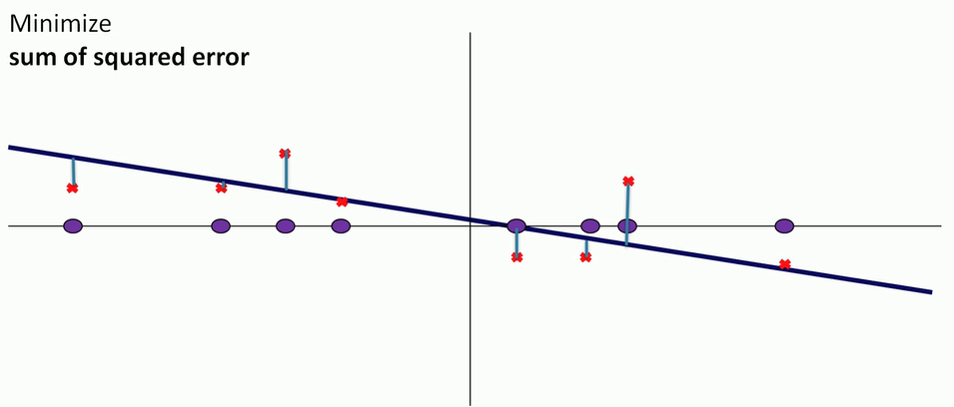
Linear Regression

Slide 8
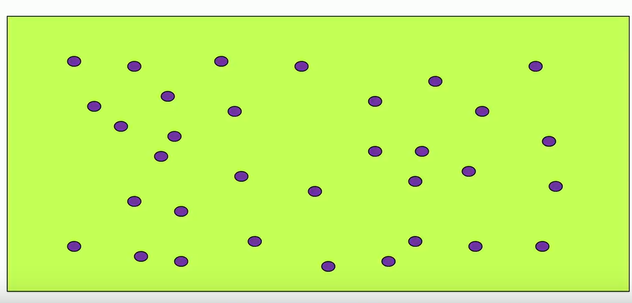
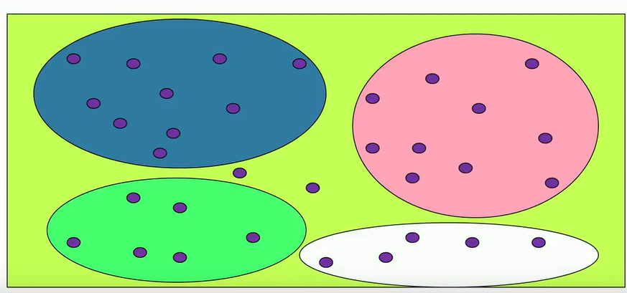
Unsupervised Learning
Unlabelled Training Data
Clustering

Slide 9
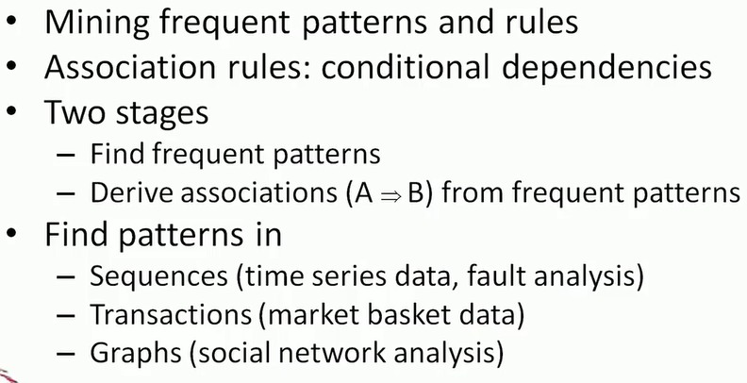
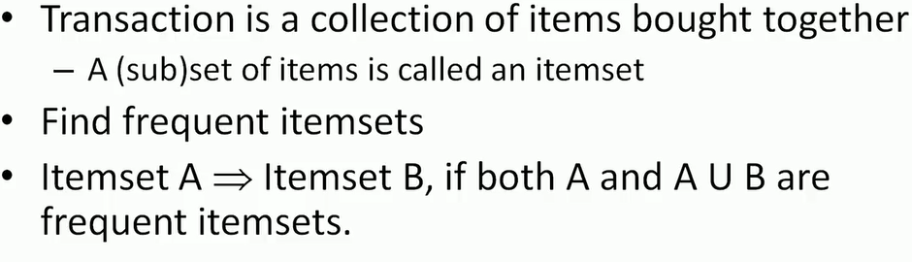
Association Rule Mining
Mining Transaction

Slide 10
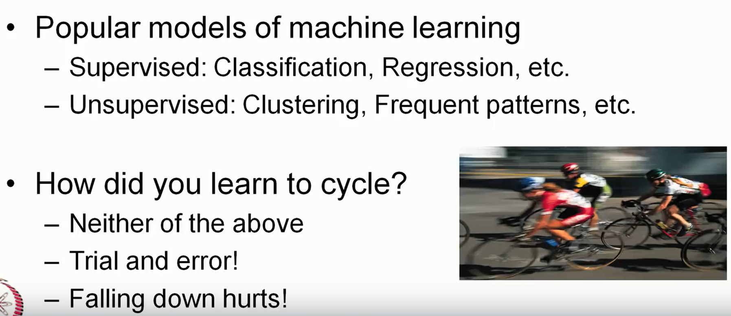
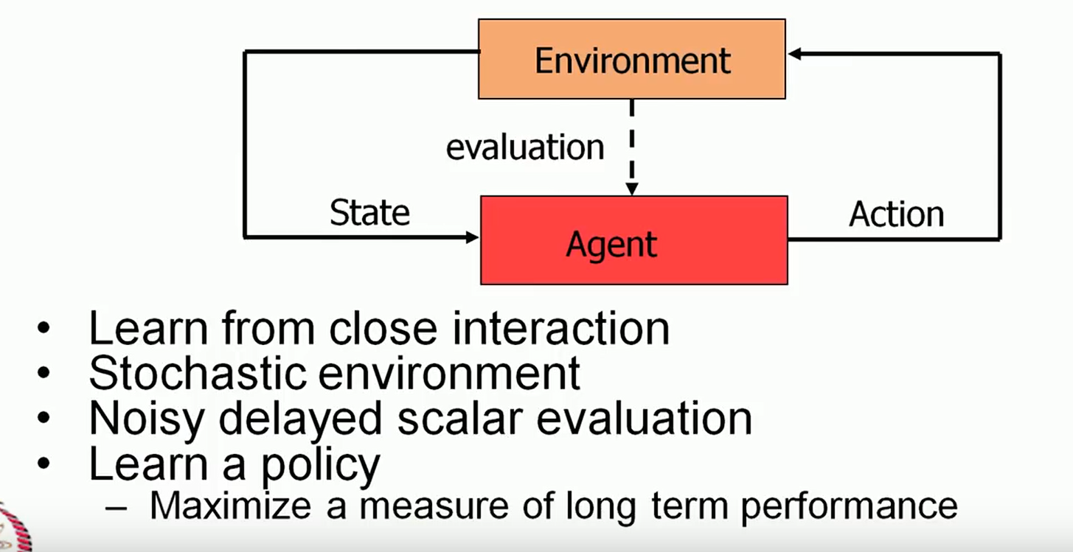
Reinforcement Learning
Learning to Control
RL Framework

Slide 11
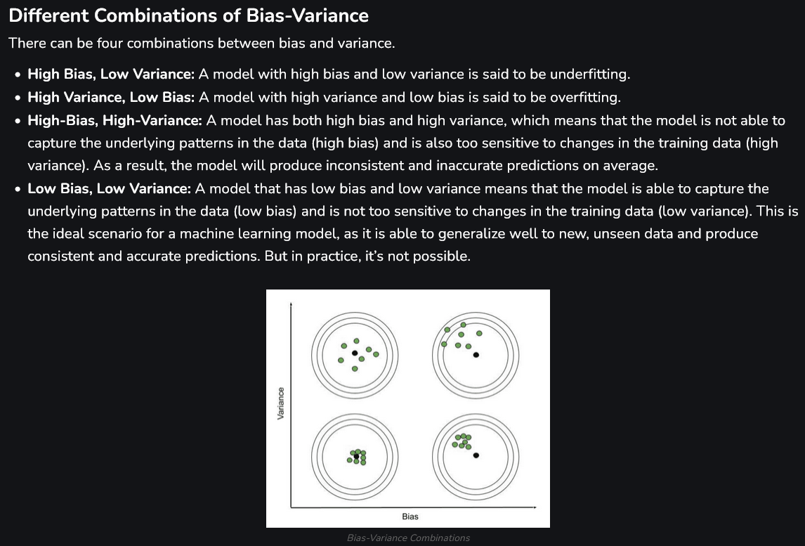
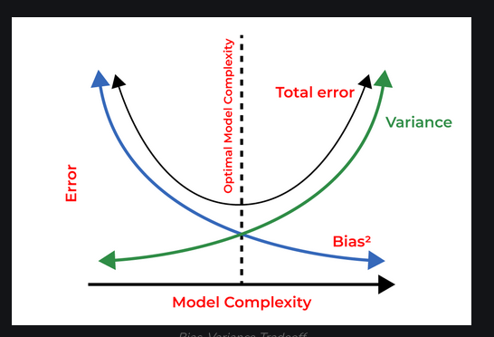
Bias
Variance
Bias is one type of error that occurs due to wrong assumptions about data such as assuming data is linear when in reality, data follows a complex function.
Variance gets introduced with high sensitivity to variations in training data.

Slide 12
Topics on which Week 1 Assignment Questions are based
Machine Learning
Supervised Learning
Unsupervised Learning
Reinforcement Learning
Bias and Variance

Slide 13
QUESTION 1
Which of the following is/are unsupervised learning problem(s)? (Multiple options may be correct)
a) Grouping documents into different categories based on their topics
b) Forecasting the hourly temperature in a city based on historical temperature patterns
c) Identifying close-knit communities of people in a social network
d) Training an autonomous agent to drive a vehicle
e) Identifying different species of animals from images
SOLUTION 1
The tasks wherein we are provided explicit training labels are called supervised learning problems(options (b), (e)).
In unsupervised learning, we need to find patterns from data even in the absence of labels (options (a), (c)).
In reinforcement learning, we learn a policy using reward signals from the environment (option (d)).
CORRECT ANSWER 1
a), c)

Slide 14
QUESTION 2
Which of the following statement(s) about Reinforcement Learning (RL) is/are true? (Multiple options may be correct)
a) While learning a policy, the goal is to maximize the long-term reward.
b) During training, the agent is explicitly provided the most optimal action to be taken in each state.
c) The state of the environment changes based on the action taken by the agent.
d) RL is used for building agents to play chess.
e) RL is used for predicting the prices of apartments from their features.
SOLUTION 2
Refer to the lecture on RL for explanations of options (a) to (d). Option (e) is a supervised learning task.
CORRECT ANSWER 2
a), c), d)

Slide 15
QUESTION 3
Which of the following is/are classification tasks(s)? (Multiple options may be correct)
a) Predicting whether an email is spam or not spam
b) Predicting the number of COVID cases over a given period
c) Predicting the score of a cricket team
d) Identifying the language of a text document
SOLUTION 3
Options (a), (d) are classification tasks as they predict categorical variables.
Options (b), (c) are regression tasks because they predict numerical variables.
CORRECT ANSWER 3
a), d)

Slide 16
QUESTION 4
Which of the following is/are regression task(s)? (Multiple options may be correct)
a) Predicting whether or not a customer will repay a loan based on their credit history
b) Forecasting the amount of rainfall in a given place
c) Identifying the types of crops from aerial images of farms
d) Predicting the future price of a stock
SOLUTION 4
Options (a), (c) are classification tasks as they predict categorical variables.
Options (b), (d) are regression tasks because they predict numerical variables.
CORRECT ANSWER 4
b), d)

Slide 17
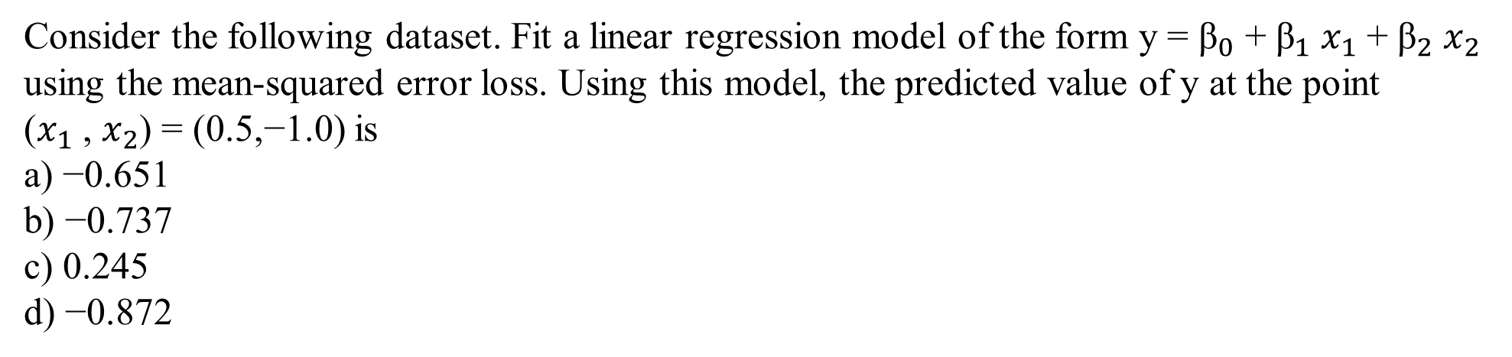
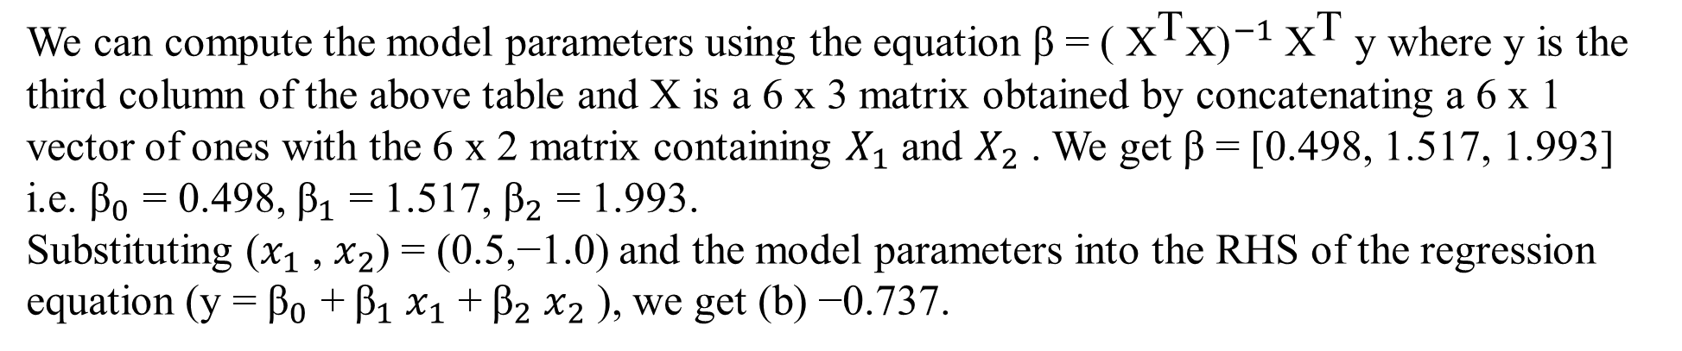
QUESTION 5
 |  | y
-1.0 | -0.5 | -1.947
-0.5 | 0.0 | -0.391
1.0 | 2.0 | 6.047
2.0 | 0.5 | 4.527
2.5 | -1.5 | 1.287
0.0 | -2.0 | -3.451
SOLUTION 5
CORRECT ANSWER 5
b)

Slide 18
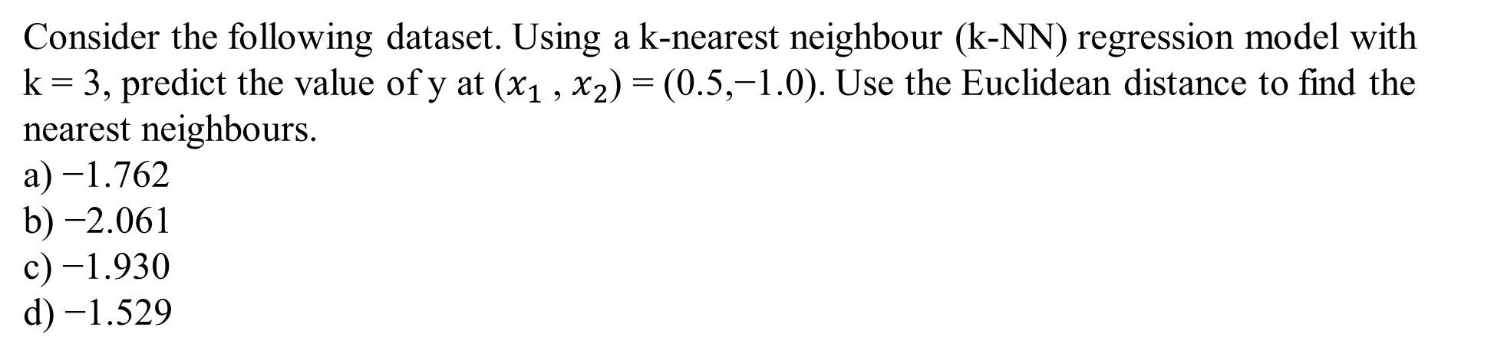
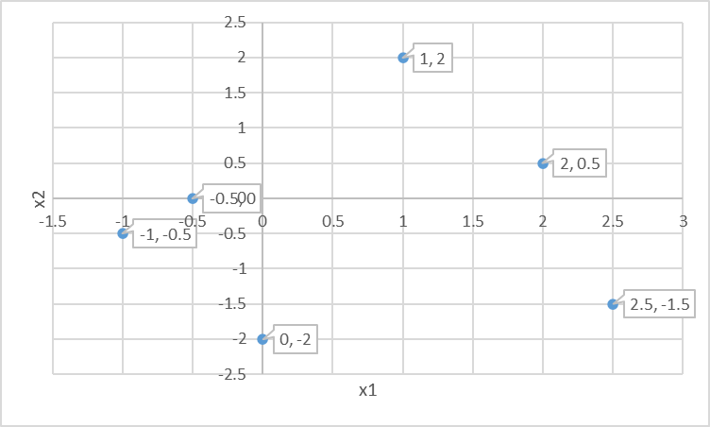
QUESTION 6
 |  | y
-1.0 | -0.5 | -1.947
-0.5 | 0.0 | -0.391
1.0 | 2.0 | 6.047
2.0 | 0.5 | 4.527
2.5 | -1.5 | 1.287
0.0 | -2.0 | -3.451
SOLUTION 6
The 3 nearest neighbours of the point (0.5,−1.0) are (−1.0,−0.5), (−0.5, 0) and (0.0,−2.0).
Taking the mean of the y values at these points, we get (c) −1.930.
CORRECT ANSWER 6
c)

Slide 19
QUESTION 7
Consider the following statements regarding linear regression and k-NN regression models.
Select the true statements. (Multiple options may be correct)
a) A linear regressor requires the training data points during inference.
b) A k-NN regressor requires the training data points during inference.
c) A k-NN regressor with a higher value of k is less prone to overfitting.
d) A linear regressor partitions the input space into multiple regions such that the prediction
over a given region is constant.
SOLUTION 7
Option (a) is false because a linear regressor only uses the learned parameters during inference.
Option (b) is true because a k-NN regressor requires the training points during inference for finding the nearest neighbours.
Option (c) is true as explained in the lecture on Bias and Variance.
Option (d) is false because the property described is that of a k-NN regressor and not of a linear regressor.
CORRECT ANSWER 7
b), c)

Slide 20
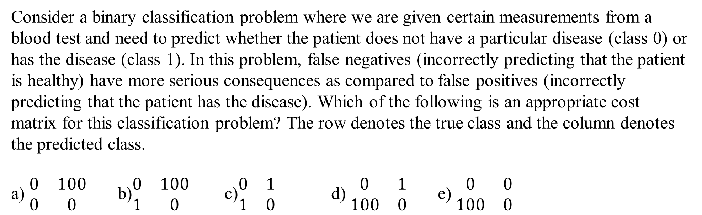
QUESTION 8
SOLUTION 8
From the details given in the question, a false negative should be penalized much more than
a false positive. However, a false positive should also receive a small but positive penalty.
CORRECT ANSWER 8
d)

Slide 21
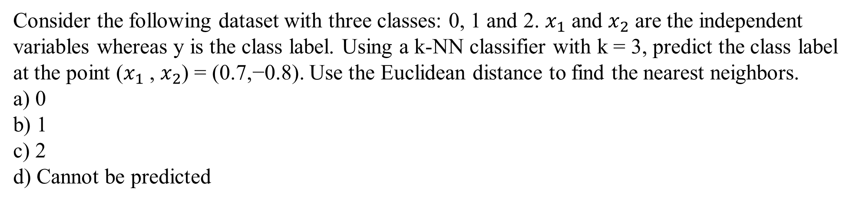
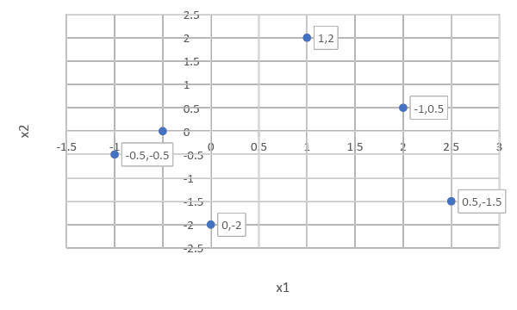
QUESTION 9
 |  | y
-0.5 | 0.0 | 0
2.0 | 0.5 | 0
-1.0 | -0.5 | 1
0.0 | -2.0 | 1
2.5 | -1.5 | 2
1.0 | 2.0 | 2
SOLUTION 9
The 3 nearest neighbors of the point (0.7,−0.8) are (−1.0,−0.5), (−0.5, 0.0) and (0.0,−2.0)
having class labels 1, 0 and 1 respectively. Taking the majority of these labels, we get class 1
as the predicted label.
CORRECT ANSWER 9
b)

Slide 22
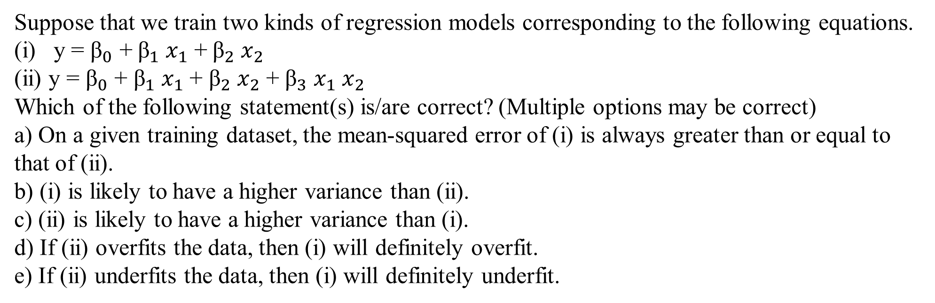
QUESTION 10
SOLUTION 10
Model (ii) is more complex than model (i). So, (ii) will have a lower mean-squared error and higher variance than (i). If a complex model overfits the data, a simpler model may or may not overfit. However, if a complex model underfits the data, a simpler model will definitely underfit.
CORRECT ANSWER 10
a), c), e)

